Slide 1
Presentation Subject : Objected Oriented Programming Topic : Abstract Modifier, Access Control Modifier, Non-Access Modifiers Group : AMS-A-04 Lecture : Mr. Tal Tongsreng (Course) Mr. Chan Sophal (TP)

Slide 2
Member Ek Vongpanharith e20200877 Kry Senghort e20200706 Koythol Amrint e20201757 Lim Sunheng e20200807

Slide 3
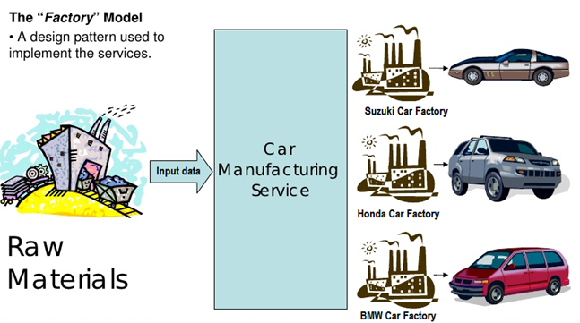
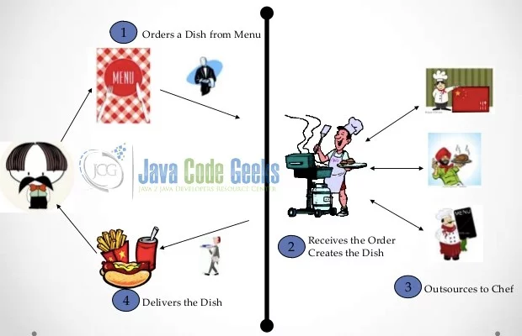
I.) Abstract Modifier The abstract modifier is a modifier that is used to indicates the thing being modified has a missing or incomplete implementation. The abstract modifier can be used with classes, methods, properties, indexers, and events

Slide 4
I.) Abstract Modifier The abstract modifier is a modifier that is used to indicates the thing being modified has a missing or incomplete implementation. The abstract modifier can be used with classes, methods, properties, indexers, and events.

Slide 5
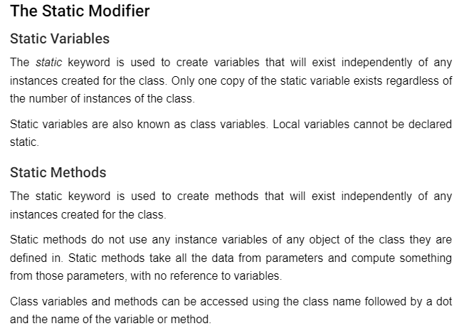
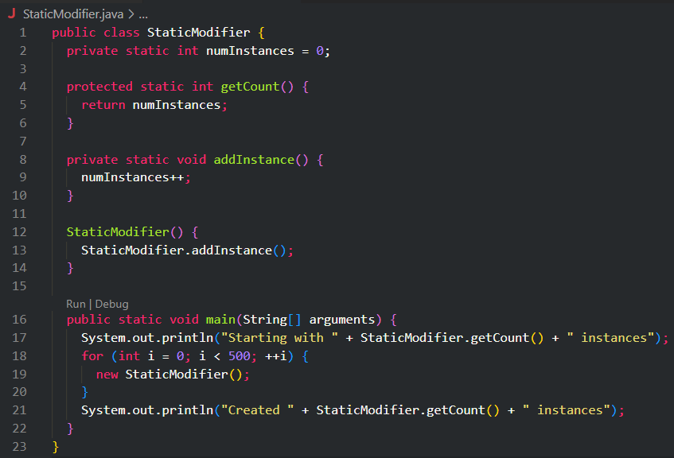

Slide 6
